Slide 1

TECHNOFUSION 1.0
TITLE PAGE
Problem Statement – City Issues And Problem Identification
Theme – Social Welfare (Public Sector)
Project Title – Clean IT - Smart Garbage Reporting System
Team Name – Master Minions
Team Member 1 – Kashish Sharma
Team Member 2 – Piyush Rathore
Team Member 3 – Dhruv Tiwari
Team Member 4 – Shashank Gupta

Slide 2

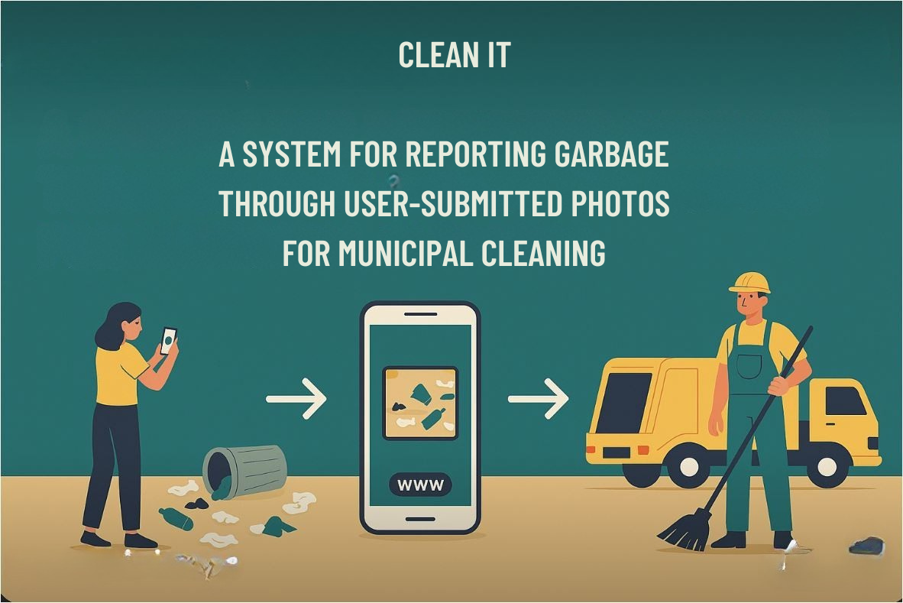

Slide 3
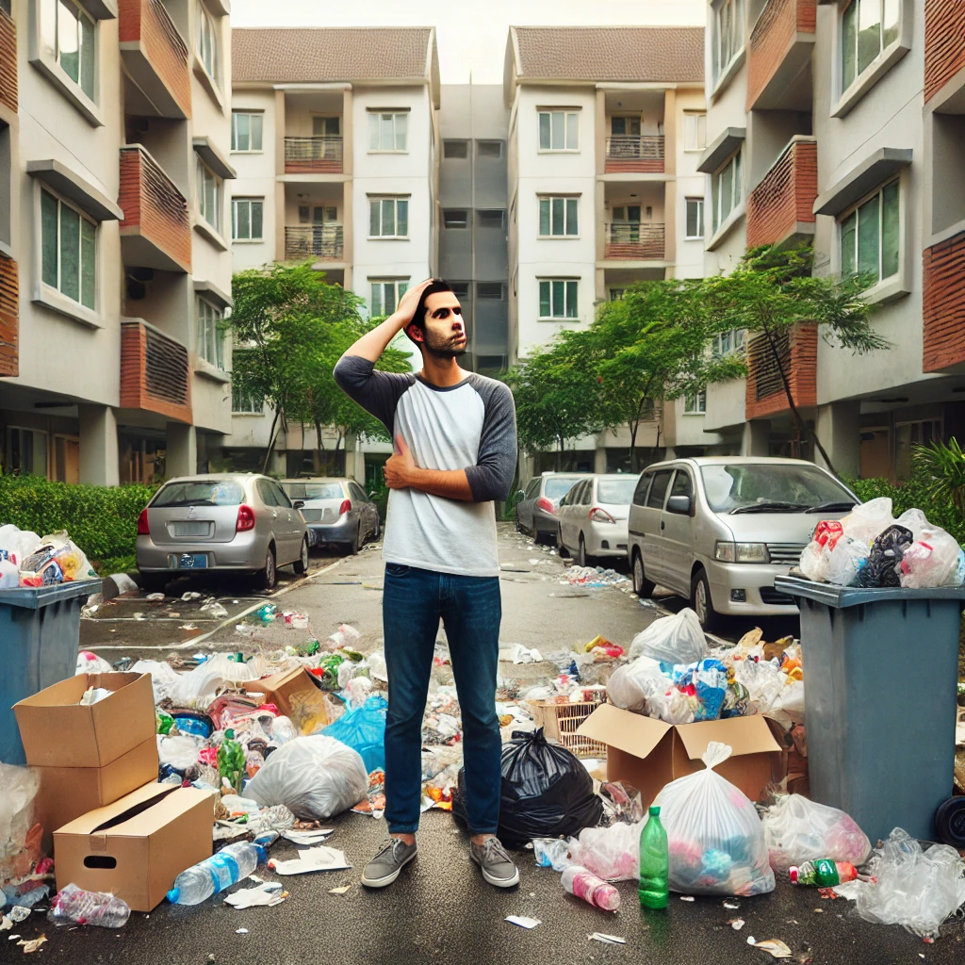
Challenge - Real-time, accurate reporting, seamless integration with municipal authorities, and maintaining scalability and user engagement for efficient waste management.
Objective - In many urban areas, garbage collection and waste management remain a significant challenge. Despite the efforts of municipal corporations, the lack of efficient reporting systems and timely actions often results in garbage piling up in public spaces. Citizens are left frustrated with limited ways to report and address these issues.
Problem - The problem is that there is no real-time, automated system for citizens to report garbage in their communities, leading to delayed responses and the continued degradation of urban spaces. A simple and efficient system is required to allow citizens to actively participate in waste management by reporting garbage with minimal effort, ensuring quicker municipal action, and promoting cleaner, healthier environments.

Slide 4

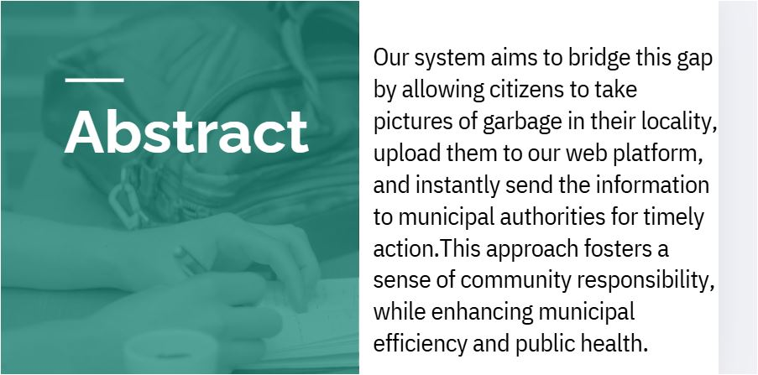

Solution Overview

Slide 5

INTRODUCTION
Presenting to you – Clean IT, a project that aims to bridge that gap by introducing a Smart Garbage Reporting System, where citizens can easily report instances of garbage by taking pictures and uploading them through a user-friendly platform. Once a report is submitted, the municipal corporation receives the data and takes prompt action to clean the area.
KEY FEATURES OF CLEAN IT
Real-Time Image Uploading:
Users can instantly capture and upload images of garbage in their locality through the app or website. This real-time feature ensures that the garbage is reported as soon as it's identified, enabling quicker municipal response times.
GPS Map Integration for Location Tracking:
The system uses GPS to accurately track and pinpoint the location of the reported garbage. This feature ensures that municipal authorities can easily locate the problem area for swift cleanup and waste management.
Automated Report Generation:
Once an image is uploaded and the location is tagged, the system automatically generates a detailed report that is sent to the relevant municipal authority.

Slide 6
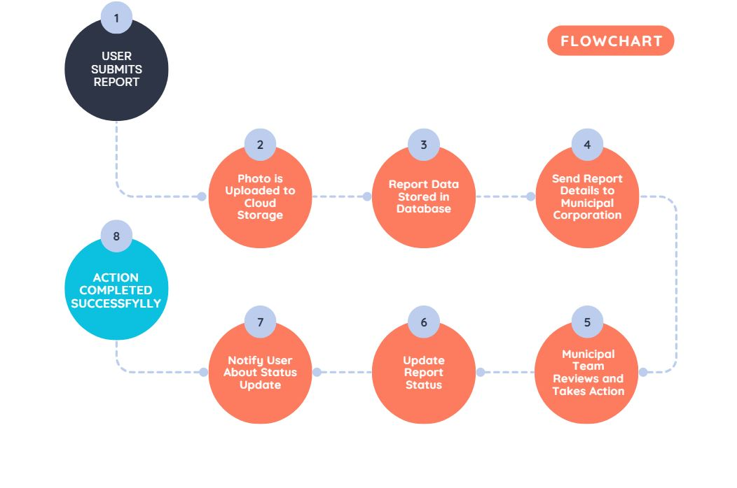
ROADMAP (System Flowchart)

Slide 7

Technologies Used
FRONTEND
HTML
CSS
JAVA SCRIPT
BACKEND (Under Progress/ to be implemented)
Node.js, Express, Python Flask, or any backend framework to handle file uploads, API requests, and database interactions.
Database:
MySQL, PostgreSQL (relational), MongoDB (NoSQL).
Cloud Storage:
Firebase Storage, or Google Cloud Storage.
Email/SMS Notifications:
services like Twilio, or Firebase Cloud Messaging (FCM).

Slide 8
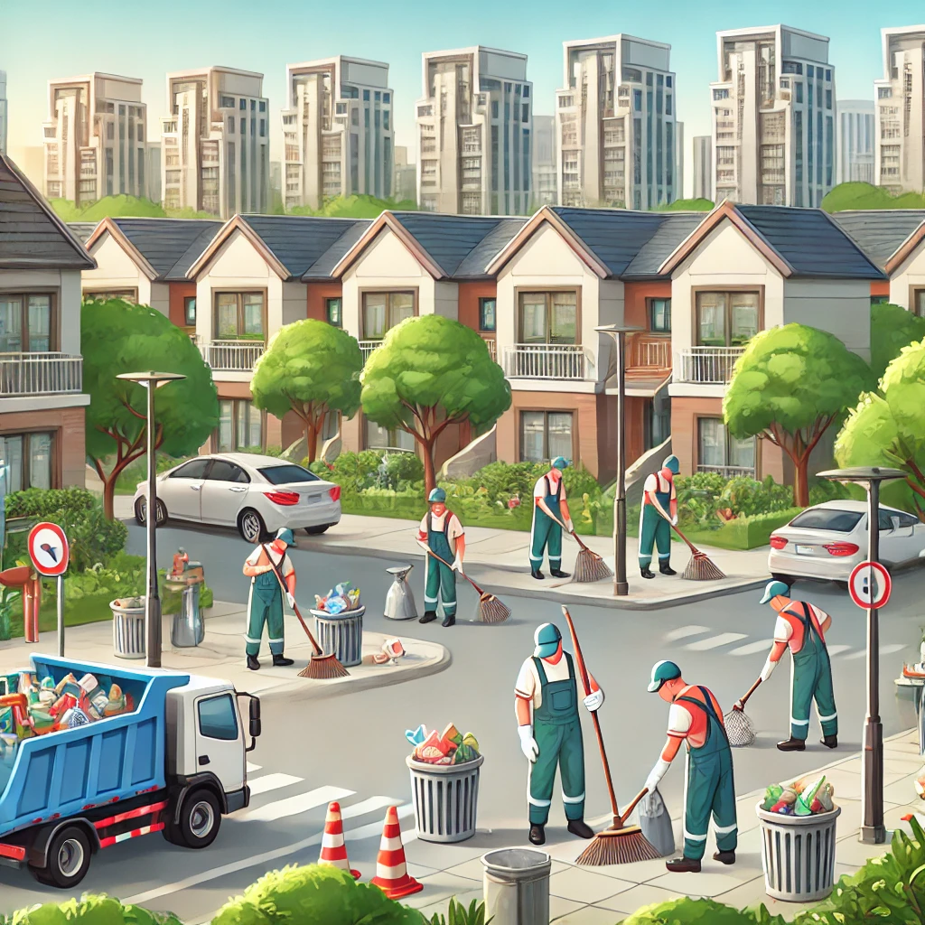
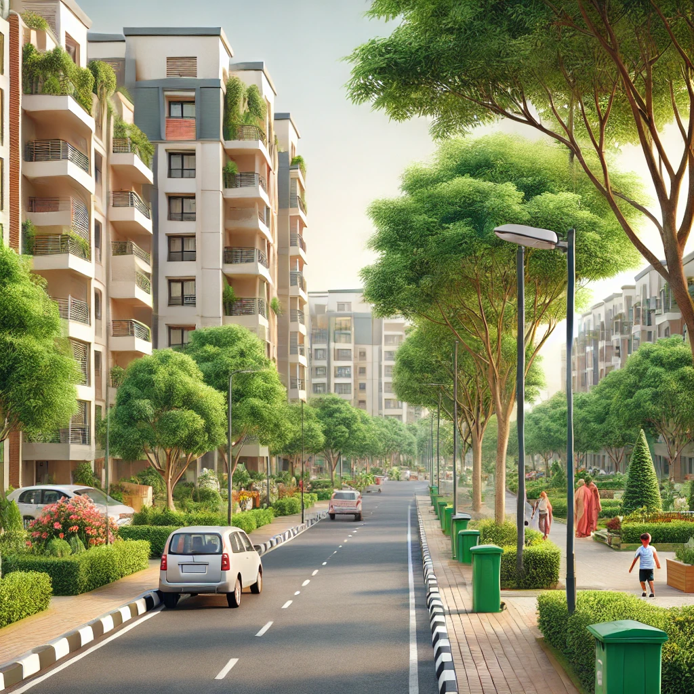
IMPACT AND BENEFITS
Improved Waste Management Efficiency
Cleaner Urban Spaces
Enhanced Citizen Engagement
Reduced Health Hazards
Environmental Sustainability
Cost Savings for Municipalities

Slide 9
Scaling and Future Scope
Unique Selling Proposition (USP):
Reporting and Municipal Integration:
Unlike traditional complaint systems, our project automates the process by capturing, uploading, and sharing garbage reports with municipal corporations. This saves time for both the users and municipal teams, improving the efficiency of waste management.
User-Friendly Interface:
The system prioritizes ease of use, allowing anyone with a smartphone to report garbage in just a few clicks. The focus on a simple and intuitive mobile experience makes it accessible to a large number of users, even those with minimal tech-knowledge.
GPS Map Integration for Accurate Reporting and Efficient Cleanup
One of the standout features of our Smart Garbage Reporting System is the integration of GPS mapping technology. This unique feature allows users to precisely pinpoint the location of the garbage they are reporting, ensuring that municipal authorities can easily identify and locate the problem area in real time.
AI and Image Recognition:
Use of AI-powered image recognition to automatically classify and identify the type of garbage (e.g., plastics, glass, organic waste) in the photos. This could help municipal teams prioritize waste disposal tasks.
Incentivizing Users:
Introduction of a reward system where users earn points or badges for reporting garbage. These rewards can be exchanged for discounts, donations, or other community-driven benefits. This could increase user engagement and participation.
Collaborating with NGOs and Environmental Agencies:
Partnering with environmental NGOs and other organizations to scale up the initiative, bringing in more volunteers and resources for clean up drives. This could include waste collection drives and recycling initiatives.

Slide 10
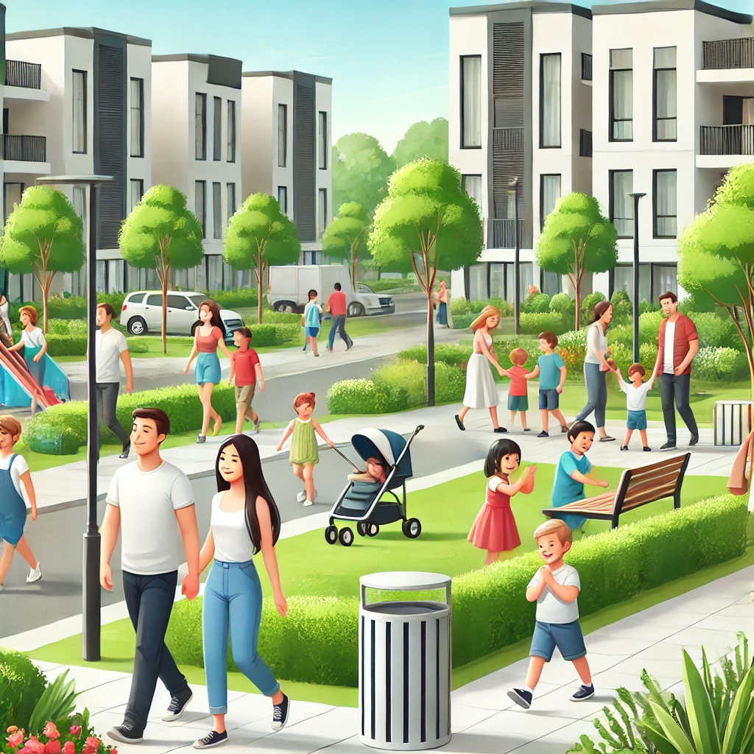

CONCLUSION
CLEAN IT presents an innovative solution to a critical issue faced by urban areas: inefficient and delayed waste management. By leveraging real-time image uploading, GPS tracking, and automated report generation, this system empowers citizens to actively participate in maintaining the cleanliness of their neighborhoods, while ensuring that municipal authorities can respond swiftly and effectively.
By putting the power of reporting and cleanup into the hands of citizens, the Smart Garbage Reporting System is paving the way for a cleaner, more responsible urban future.

